Slide 1


Department of Computer Science and Engineering
CS19643 – FOUNDATIONS OF MACHINE LEARNING
INTELLIGENT THREAT DETECTION SYSTEM
Akshaya R
210701023
Balaharinath C 210701037
Dr.S. Vinodkumar
Professor

Slide 2
Abstract
This project presents an innovative Intrusion Prevention System (IPS) that combines a proxy server with a machine learning model to analyze HTTP traffic in real-time. Leveraging the k-means clustering algorithm, the model discerns between normal and malicious HTTP requests. Through rigorous testing against a vulnerable web application using SQL injection payloads, the system demonstrates its capability to accurately identify and thwart intrusion attempts. Notably, the machine learning model exhibits high accuracy in detecting malicious requests, thereby enhancing network security. This integration of machine learning and proxy server technologies showcases a promising approach to proactive threat detection and prevention in cybersecurity.

Slide 3
Existing System
The existing system comprises traditional network security measures, including firewalls, intrusion detection systems (IDS), and antivirus software. While these tools offer fundamental protection against known threats, they often fall short in detecting and mitigating sophisticated attacks, such as zero-day exploits and polymorphic malware. IDS, for instance, relies on signature-based detection methods, making it susceptible to evasion techniques employed by advanced attackers. Additionally, firewalls primarily focus on packet filtering and access control, leaving vulnerabilities in the application layer unaddressed. Moreover, the reactive nature of these systems poses challenges in responding to emerging threats in real-time. As cyber threats continue to evolve in complexity and sophistication, there is a pressing need for more advanced and proactive security solutions capable of identifying and mitigating both known and unknown threats effectively.

Slide 4
Proposed System
The proposed system aims to enhance network security through the integration of an advanced Intrusion Prevention System (IPS). Building upon the foundation of machine learning and proxy server technologies, the system will employ sophisticated algorithms to analyze HTTP traffic in real-time. Key components include a proxy server for intercepting and scrutinizing incoming requests, and a machine learning model trained on historical data to identify patterns indicative of malicious behavior. The system will undergo extensive testing against various attack scenarios to vali its efficacy in detecting and mitigating intrusion attempts. Additionally, proactive defense mechanisms such as anomaly detection and predictive analytics will be integrated to enhance threat intelligence and response capabilities.

Slide 5
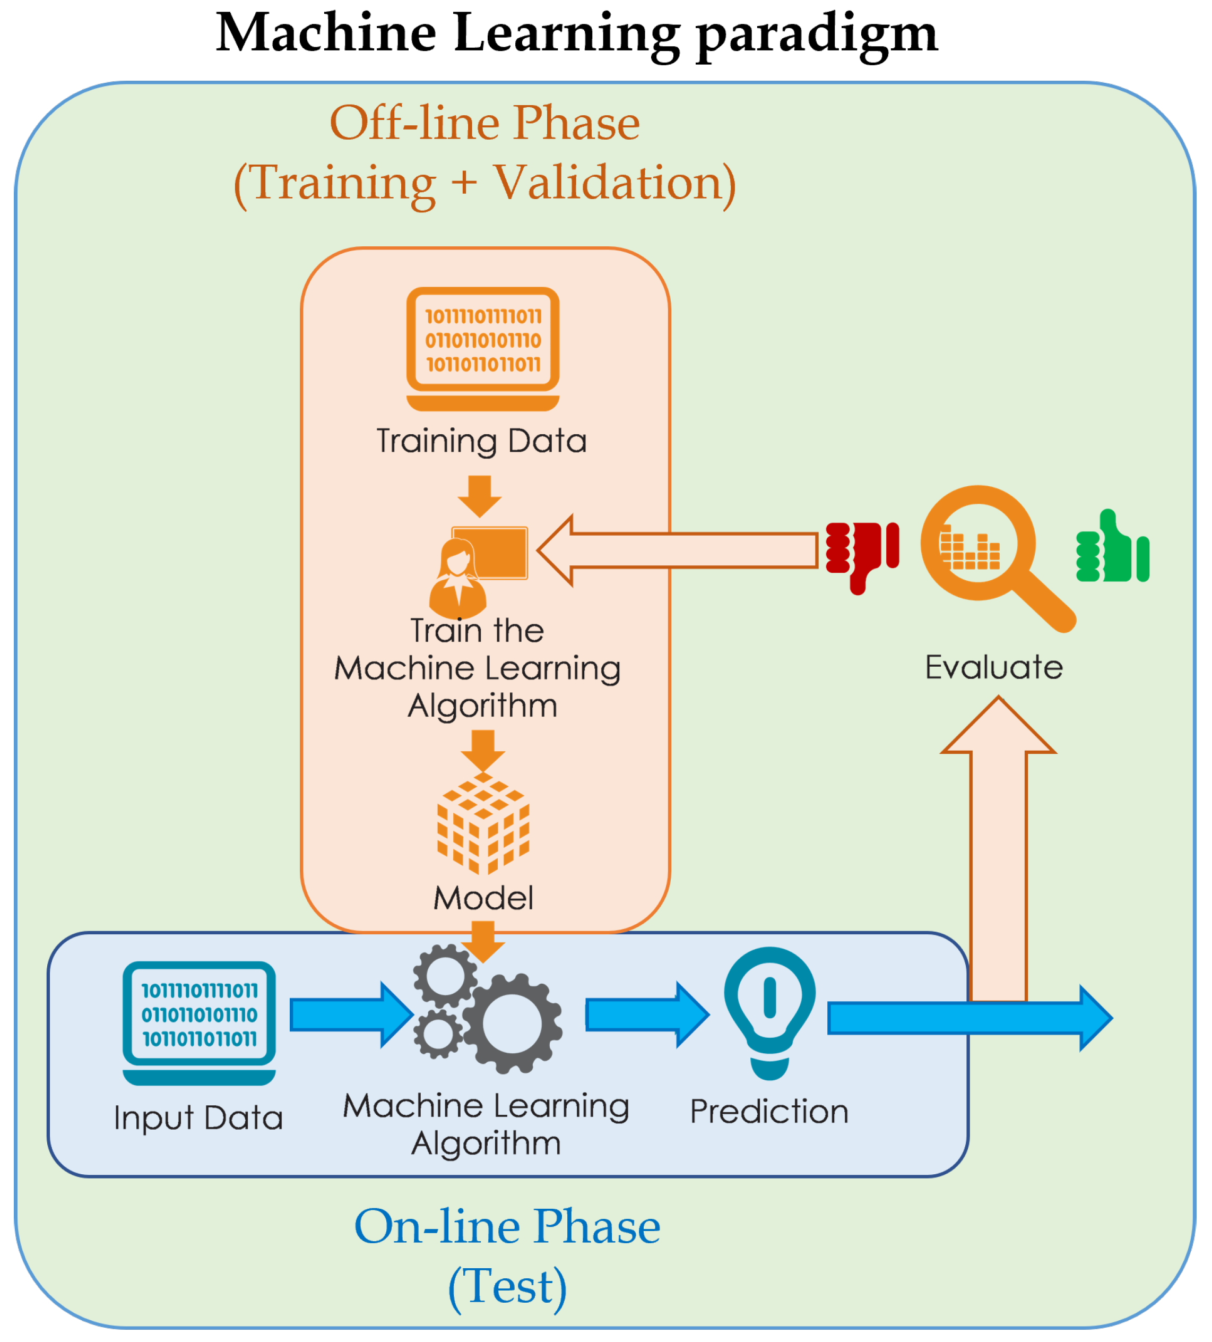
System Architecture

Slide 6
List of Modules
Creation of Dataset
Training the machine learning model
Proxy Server Integration
Testing

Slide 7
Functional Description for each modules
Creation of Dataset:The first step is data collection, which entails gathering raw data representing HTTP traffic from various sources such as network logs, packet captures, or simulated environments. This data should encompass a diverse range of HTTP requests, including legitimate traffic as well as various types of attacks and anomalies.

Slide 8
Functional Description of Module
Training the machine learning model:The Training Machine Learning Model module is a crucial component of the overall system designed for intrusion prevention through real-time HTTP traffic analysis. This module focuses on utilizing machine learning algorithms to train models capable of distinguishing between normal and malicious HTTP requests. By analyzing historical HTTP traffic data, the module aims to identify patterns and features indicative of malicious behavior, enabling the system to proactively detect and prevent intrusions.

Slide 9
Functional Description of Module
Proxy Server Integration:The Proxy Server Integration module is a pivotal component within the framework of an Intrusion Prevention System (IPS) aimed at real-time analysis of HTTP traffic. This module seamlessly integrates the functionalities of a proxy server with machine learning algorithms to intercept, analyze, and take action on incoming HTTP requests, thereby enhancing network security and thwarting potential intrusion attempts.

Slide 10
Functional Description of Module
Testing: Testing the final output of the Intrusion Prevention System (IPS) is a critical phase to ensure its effectiveness in identifying and mitigating potential security threats in real-world scenarios. This testing phase involves subjecting the system to various test cases, simulating different types of attacks, and evaluating its performance based on predefined metrics and criteria.

Slide 11
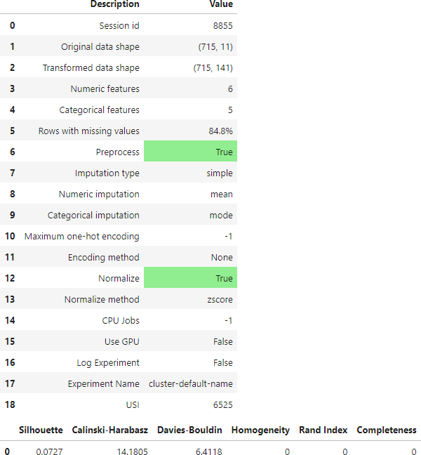
Output

Slide 12
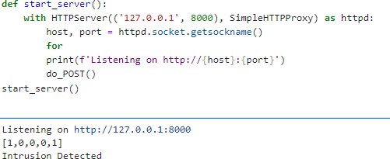
Output

Slide 13
Conclusion
In conclusion, the development and implementation of the Intrusion Prevention System (IPS) represent a significant advancement in enhancing network security and mitigating potential cyber threats. By integrating machine learning algorithms with proxy server technology, the IPS demonstrates promising capabilities in real-time analysis and detection of malicious HTTP traffic.Through rigorous testing and evaluation, we have validated the effectiveness of the IPS in accurately identifying and mitigating various types of attacks, including SQL injection, cross-site scripting (XSS), and command injection. The system's ability to adapt and evolve in response to evolving threat landscapes underscores its relevance in today's dynamic cybersecurity environment.

Slide 14
References
McHugh, J., Christie, A., & Allen, J. (2000). Defending yourself: The role of intrusion detection systems. IEEE Software, 17(5), 42-51.
Mell, P., & Scarfone, K. (2007). Guide to intrusion detection and prevention systems (IDPS). National Institute of Standards and Technology (NIST) Special Publication, 800-94.
Krawetz, N. (2007). Introduction to network intrusion detection: IDSs, IPSs, and firewalls. Syngress Publishing.
Gao, D., Xu, L., & Wu, H. (2017). A survey of machine learning algorithms for big data analytics. Biomedical Engineering and Clinical Medicine, 1(1), 1-9.
Bishop, C. M. (2006). Pattern recognition and machine learning. Springer.

Slide 15
References
5. Russell, S. J., & Norvig, P. (2016). Artificial intelligence: A modern approach. Pearson Education Limited.
6. Pedregosa, F., Varoquaux, G., Gramfort, A., Michel, V., Thirion, B., Grisel, O., ... & Vanderplas, J. (2011). Scikit-learn: Machine learning in Python. Journal of Machine Learning Research, 12(Oct), 2825-2830.
7. Abadi, M., Barham, P., Chen, J., Chen, Z., Davis, A., Dean, J., ... & Kudlur, M. (2016). TensorFlow: A system for large-scale machine learning. In 12th USENIX Symposium on Operating Systems Design and Implementation (OSDI 16) (pp. 265-283).
8. Zhou, X., Liu, S., & Zang, W. (2019). Machine learning-based intrusion detection system: A systematic review. Journal of Network and Computer Applications, 135, 1-17.

Slide 16
Thank You

